Slide 1
A Distributed Exergame for Telerehabilitation: An Engaging Alternative to Improve Patients' Quality of Life
Carlos Henrique Rorato Souza
Daniel Machado de Oliveira
Luciana de Oliveira Berretta
Sérgio Teixeira de Carvalho

Slide 2
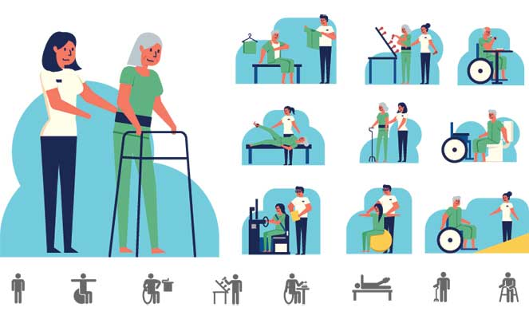
Patients Rehabilitation: Effectiveness
Availability of treatment
Active participation of the physiotherapist
Patient's motivation and engagement in the exercises
Considering the telerehabilitation scenario,
the problems add up and intensify...

Slide 3
Objective:
This project presents a distributed exergame, that aims to help telerehabilitation sessions that use a
cycle ergometer as a device.

Slide 4
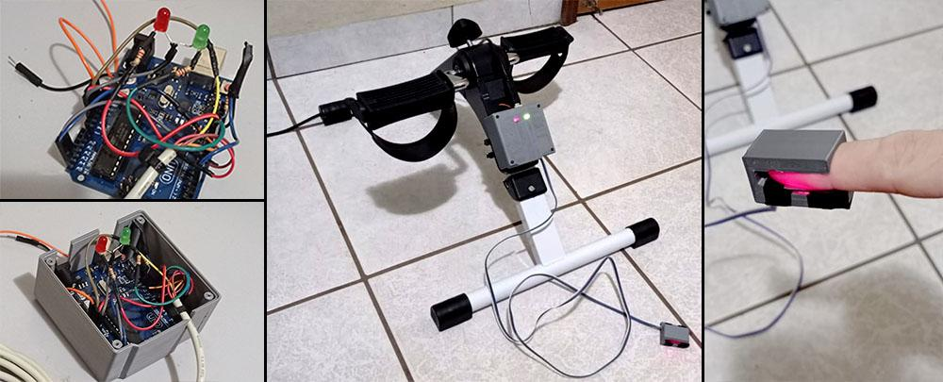

Slide 5
Exergame: Some Details
The game, which design is based on the endless runner model, presents an avatar with a bicycle controlled by the patients' pedaling on the cycle ergometer and an auxiliary joystick that allows more movements.
The goal is to collect as many coins as possible throughout the race, avoiding obstacles, within the time stipulated by the physiotherapist.
Vital patient data and other information are shown on the patient and healthcare professional's screen in real time, using real-time system techniques. In addition, the solution allows for audio and video communication, through an embedded video call implementation.

Slide 6
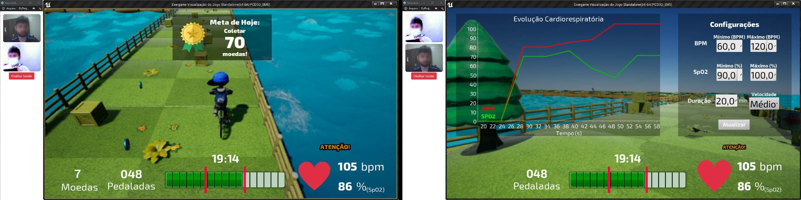
Pacient’s screen
Physiotherapist’s screen
The game was developed in a distributed architecture as a multiplayer, with each actor (patient and physiotherapist) being a player, even though they perform different functions.

Slide 7
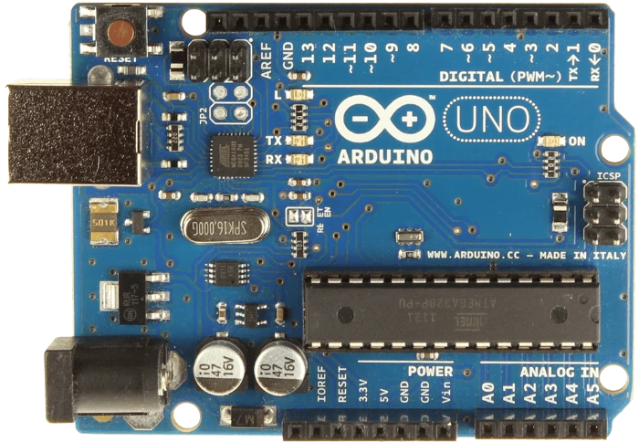
Distributed Architecture:
Server
Physiotherapist
Pacient

Slide 8
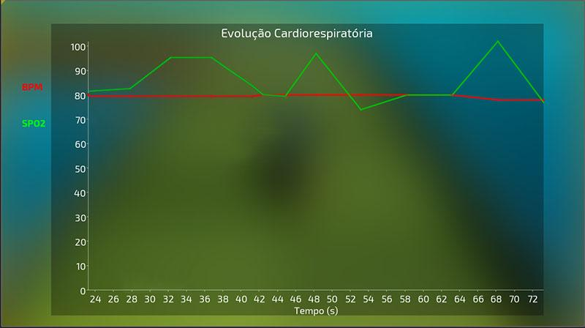
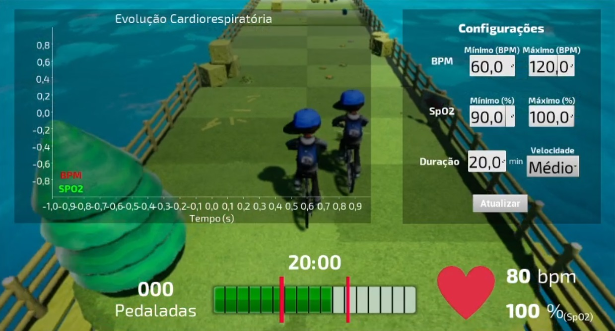
Starting the game
Initial configuration
Starting the activity - physiotherapist can interact!
Ending up the activity - general report

Slide 9
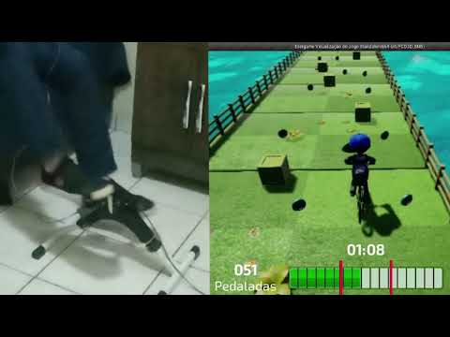

Slide 10
Thank you!

